Slide 1
Entertainment 6:
Next on Netflix
Kyle Brown, Jarrett Fein, Keara Hayes,
Jana Ratzloff, Sania Sinha, and Dan Smieszny
CMSE 202 Section 3
4/26/2022
Notes:
Person 1: Jana

Slide 2
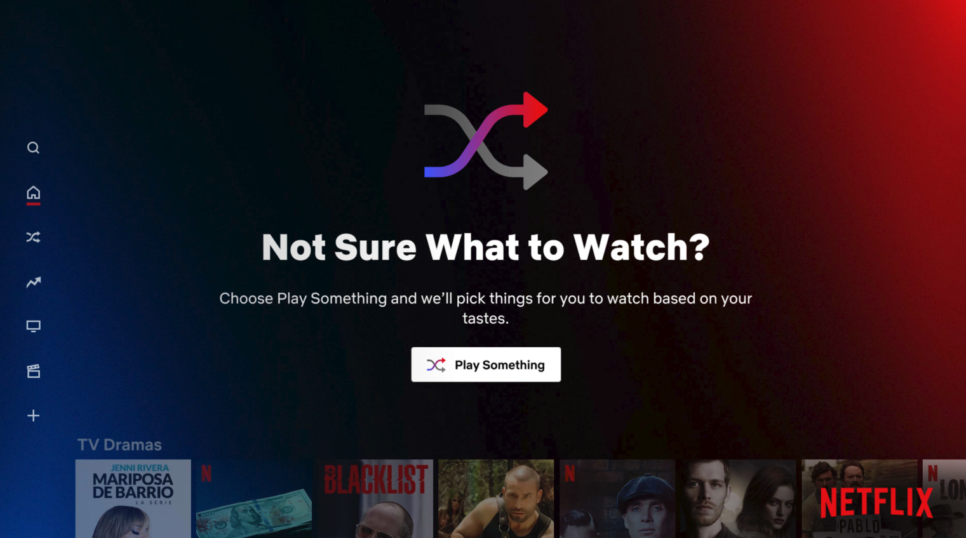
Project Background
1st world problem: you don’t know what to watch next on Netflix
Notes:
Person 1: Kyle

Slide 3
Project Premises
Original Task:
Predict the genre of the next TV show or movie of a Netflix user.
Modified Task:
Recommend the next movie and/or show to watch
Recommend multiple based on entire watch history
Considerations:
Watch next is based off the one previous thing you just watched
Netflix Home is based off your entire watch history
Watch history is all of the previous things you’ve watched
Notes:
Person 1: Kyle

Slide 4
Our Approach
Make several different recommendation systems and compare the results
Jana’s system is based on movie ratings
Keara’s system uses a movie or show title, description, cast and director
Sania’s system uses movie director, plot summary and genre
Jarrett’s system uses data given in a user’s “NetflixViewingHistory.csv” file
Dan’s system uses title similarity and genre
Packages used: sklearn, pandas, numpy, matplotlib, ast, difflib
Netflix watch history data courtesy of: Dan, Jarrett, Kyle
Notes:
Person 1: Kyle

Slide 5
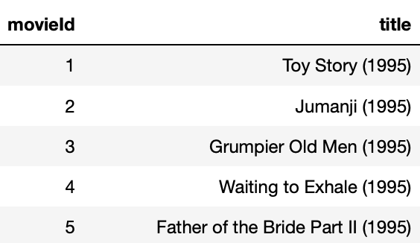
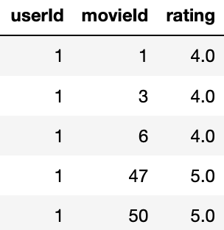
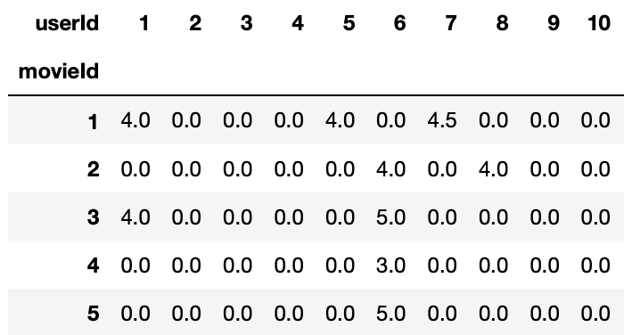
Jana’s System - Recommendations Based on Ratings
Movies dataset gives each movie title an ID
Ratings dataset shows each users rating for each movie identified by ID
Ratings are 0-5, 5 = best, 0 = user did not rate that movie
Combine into one big dataset
Not all ratings are equal
Ex: restaurant with one hundred 5-star reviews >> restaurant with one 5-star reviews
https://grouplens.org/datasets/movielens/latest/
Notes:
Person 1: Jana

Slide 6
Jana’s System - Recommendations Based on Ratings
user_threshold = # of people that voted for a movie to qualify that movie
movie_threshold = # of movies a user needs to have voted for to qualify their opinions
movie_name = manual input of the movie title
Recommendation system is limited to movies within the dataset
number_to_recommend = # of movies we want the recommendation system to output
System uses the KNN algorithm to compute similarity with cosine distance metric
The closer the distance is to 1, the higher up on the recommendation list
Notes:
Person 1: Jana

Slide 7
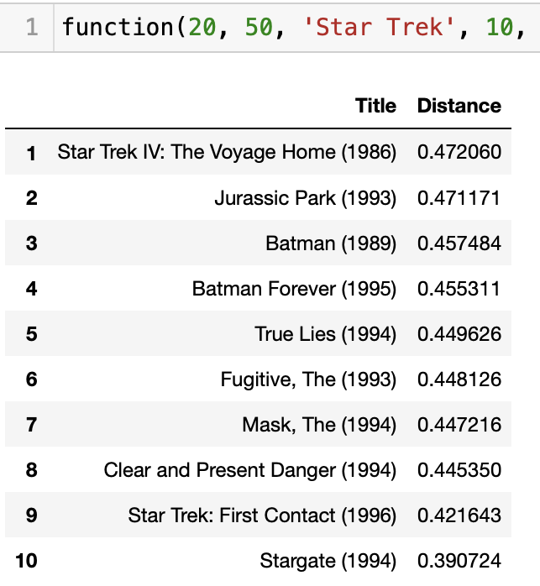
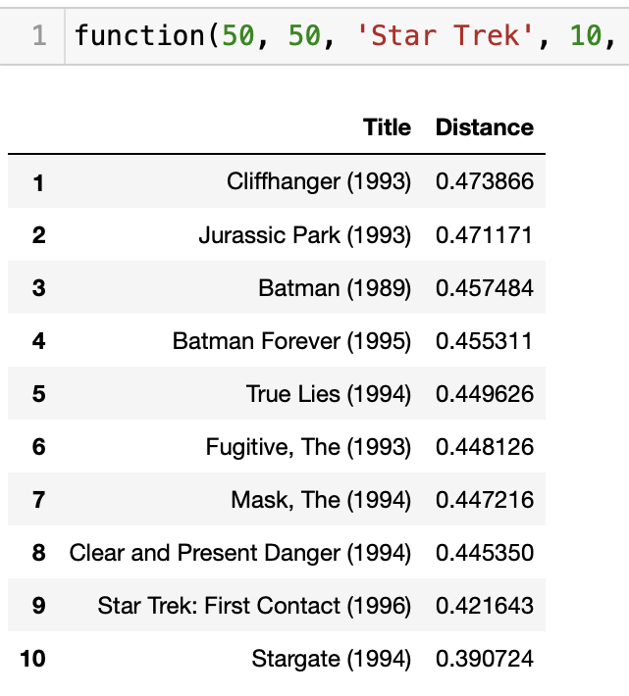
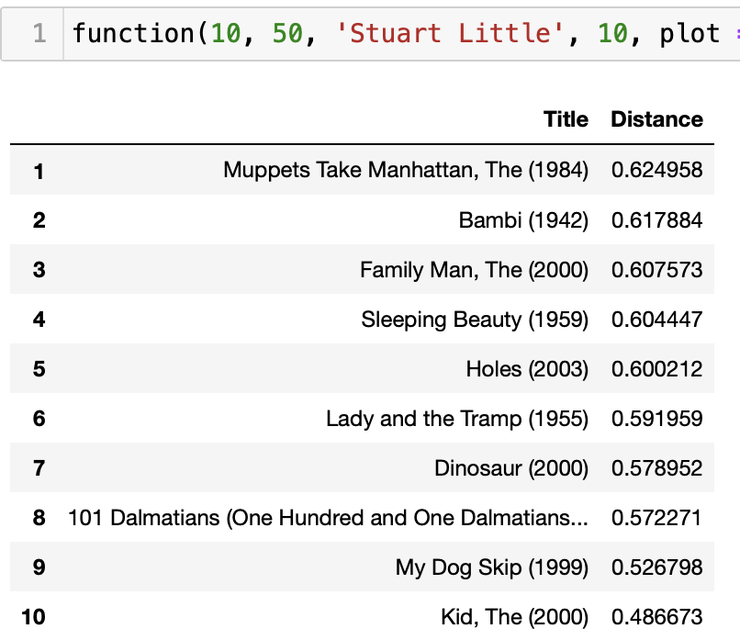
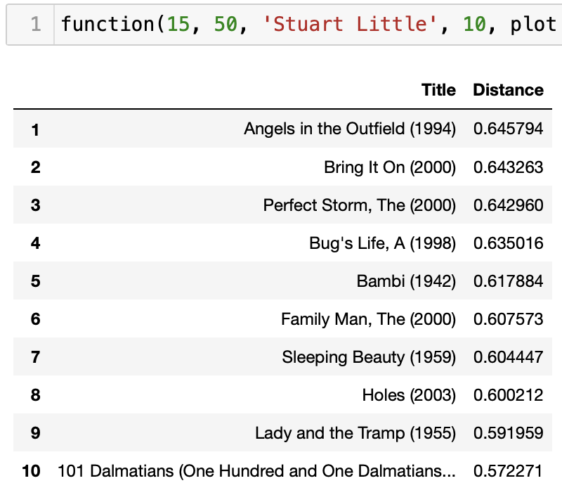
Jana’s System - Recommendations Based on Ratings
Star Trek and Stuart Little were imputed into the system with different
user thresholds (# of people that voted for a movie to qualify that movie)
Notes:
Person 1: Jana

Slide 8
Keara’s Watch Next - Recommendations Using TFIDF
TFIDF - Term Frequency Inverse Document Frequency (or, word frequency, in short)
You feed the function a film or show, and it spits out a recommendation.
Recommendation based on similarities between title, description, cast, and director
Gives films and shows similarity scores for each metric, and these scores are combined to recommend the “best” option.
Notes:
Person 2: Keara

Slide 9
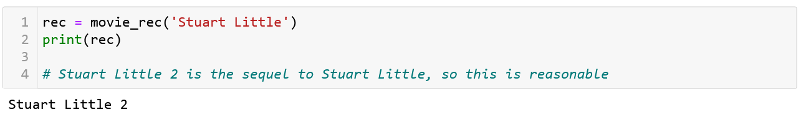
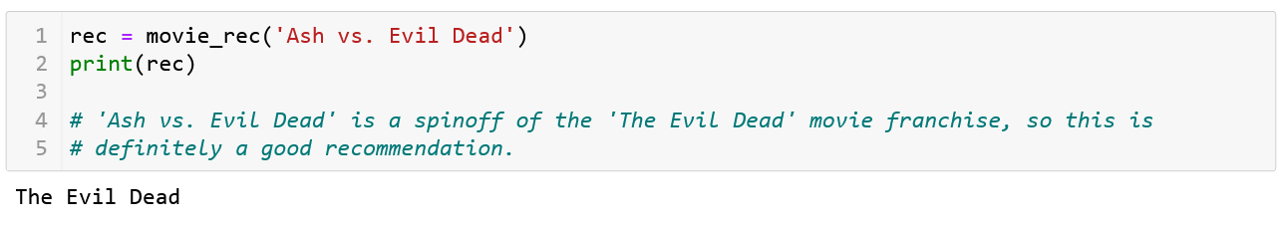
Keara’s Watch Next - Recommendations Using TFIDF
It works pretty well, too!
Notes:
Person 2: Keara

Slide 10
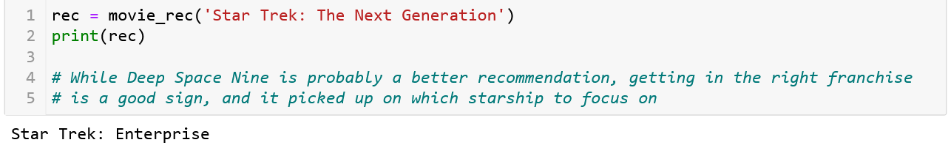
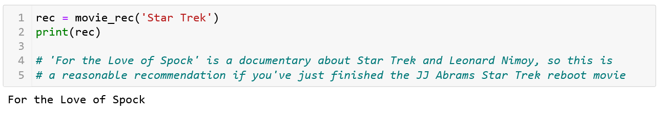
Keara’s Watch Next - Recommendations Using TFIDF
And, since there’s so much Star Trek in Jarrett’s watch history:
Notes:
Person 2: Keara

Slide 11
Keara’s Watch Next - Recommendations Using TFIDF
Limitations:
There's a chance that a movie/show won't have a perfect correlation with itself, so it isn't excluded from the recommendation list and may accidentally be recommended to the user.
Sometimes the descriptions in the csv used for this aren't very good, leading to erroneous recommendations.
Notes:
Person 2: Keara

Slide 12
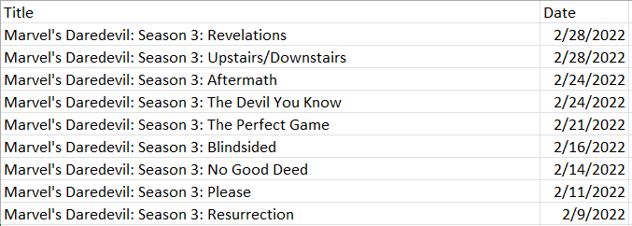
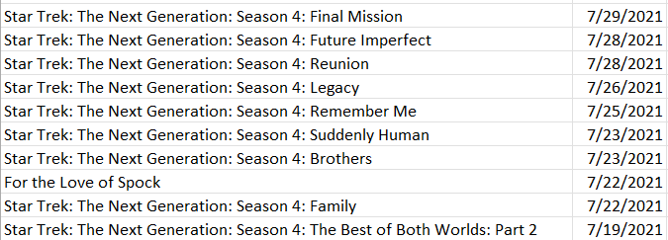
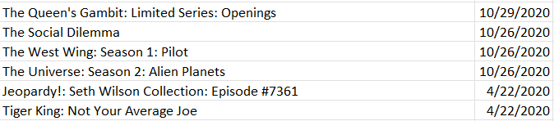
Jarrett’s Netflix Home: Netflix User Data
All Netflix users have access to their watch history via a file called “NetflixViewingHistory.csv”
Only recorded data that Netflix provides to users; they likely collect more
Not a lot of information to go on!
Notes:
Person 3: Jarrett

Slide 13
Jarrett’s Netflix Home: Netflix User Data
Take note of words in titles
Count number of episodes of a given series
Calculate number of days since since watching
Remove redundant information
From this, we can comb the Netflix library for movies and shows with similar titles (i.e. contains the same words) and assign them weights based on the numbers we’ve extracted.
Weights will be “episodes per day” of each show in our history. Shows and movies similar in title to highly weighted watched items in our history will be rated higher.
Notes:
Person 3: Jarrett

Slide 14
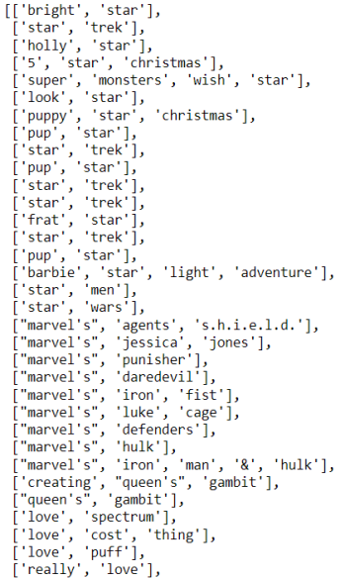
Jarrett’s Netflix Home: Netflix User Data
Some titles appear to be repeated (5 instances of “Star Trek”). This is a disadvantage of the way I cleaned my titles; each of these series has a subtitle following a colon which isn’t shown because of my code.
Results:
Not all recommendations are good. The heavy weight on “Star Trek” causes “Barbie Star Light Adventure” to be rated very highly because both contain the word “Star.” This doesn’t make sense as a recommendation for me, but it is a perfectly valid result for this algorithm.
“Star Trek” received the highest weight, followed by “Marvel’s Daredevil” and “The Queen’s Gambit.” Therefore, all items that share a common word with “Star Trek” show up first, followed by those that share a word with “Marvel’s Daredevil,” etc.
There are more items ranked below this. All items on Netflix that share so much as a single word with anything I’ve ever watch receive a nonzero weight.
Notes:
Person 3: Jarrett

Slide 15
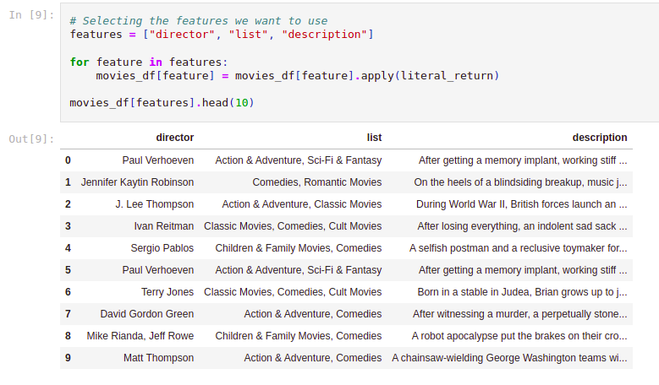
Sanya’s Netflix Home: Cosine Similarity Matrix
Build a ‘soup’ of information from all previously watched shows
Features used: director, genre, plot summary keywords
Final database created of ‘soups’ of watched and unwatched movies
Notes:
Person 4: Sanya

Slide 16
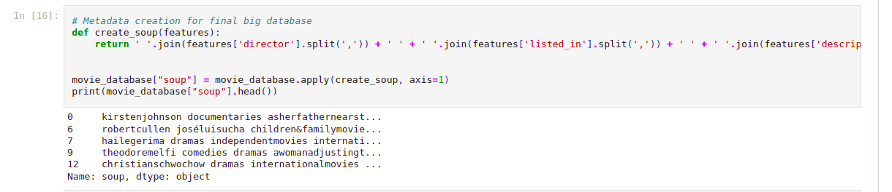
Sanya’s Netflix Home: Cosine Similarity Matrix
Similarity matrix constructed
Select top 10 similar entries except top ranked one, for index representing previously watched movies
Top ranked movie is identical to soup of all watched movies
Notes:
Person 4: Sanya

Slide 17
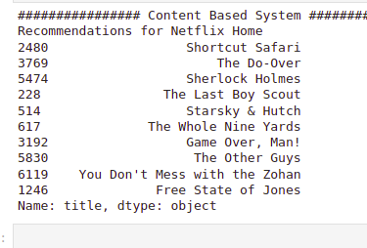
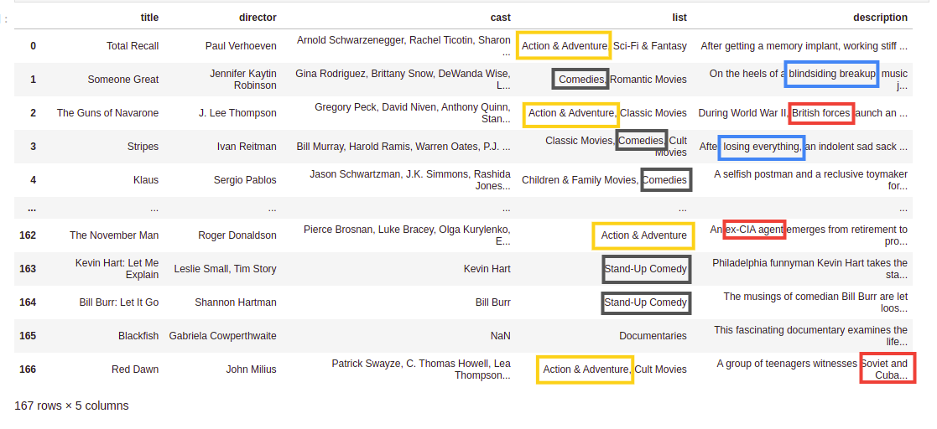
Sanya’s Netflix Home: Final Recommendations
Works pretty well
Multiple movies starring Bruce Willis despite cast not being a feature
Notes:
Person 4: Sanya

Slide 18
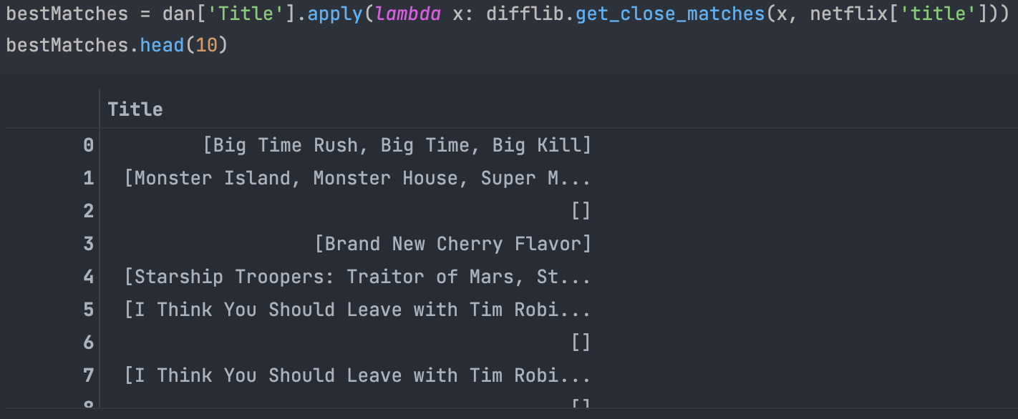
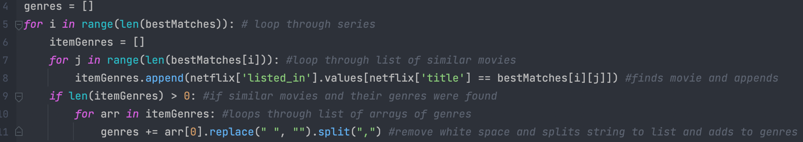
Dan’s Netflix Home: Title Similarity & Genre
Give recommendations on how similar titles are to watch history, and their genre
Using similarity, select titles similar to those in the watch history, from the netflix data
Loop through all movies found and collect their genres
Once you have the genres construct a dictionary of genre: [movies]
For the top ten most genres find the titles that are most similar to watch history and display the top 20
Notes:
Person 5: Dan

Slide 19
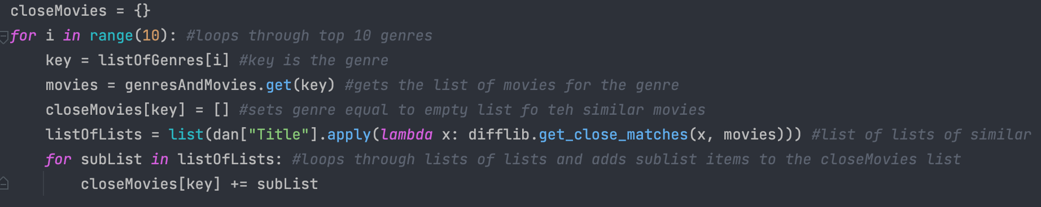
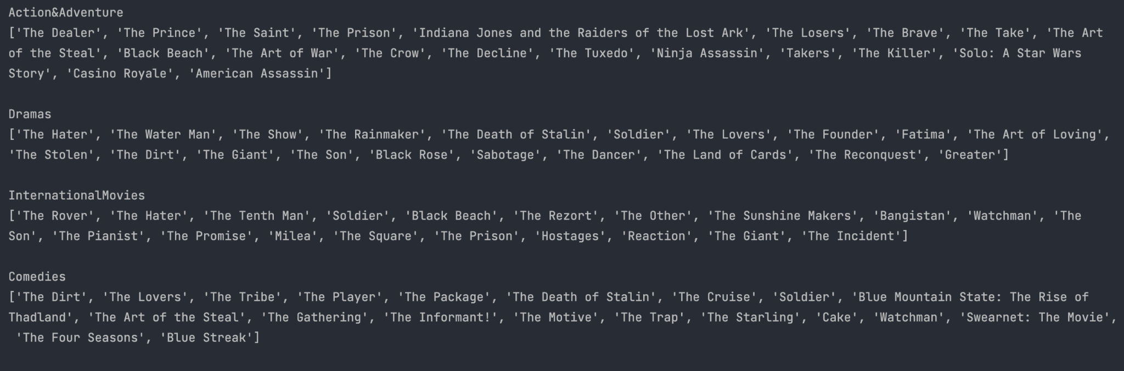
Dan’s Netflix Home: Title Similarity & Genre
Notes:
Person 5: Dan

Slide 20
Dan’s Netflix Home: Title Similarity & Genre
Limitations:
Having stopwords in the titles (eg. “The”) can add bias when looking at title similarity
One fix would removing specific stop words from the title
Not all titles in watch history were in the netflix database, which led to using similarity to find genres of items in watch history
Notes:
Person 5: Dan

Slide 21

Conclusions, Limitations & Future Scope
Recommendation systems could make predictions
How successful were they? It’s up to the opinion of a particular Netflix user
There is not dataset with all of the movies or TV shows on Netflix
Netflix is constantly adding and removing content
Possibility of combining approach based on recency and duration of watch and cosine similarity approach for Netflix Home
Check us out on GitHub!
Notes:
Person 1: Kyle

Slide 22

THANKS FOR WATCHING
Notes:
Person 6: Sanya

